Slide 1

XANBELL
TECHNOLOGIES
May, 2017
Business Profile

Slide 2
CONTENT
1
ABOUT US
2
OUR SERVICES
3
TECHNOLOGY
4
METHODOLOGY
5
COMMUNICATION MODEL
6
RELEVANT CASE STUDIES
www.xanbell.com

Slide 3
About us
Business Profile
XanBell is IT company setup by senior IT professional entrepreneurs worked in companies liked EMC, IBM, Oracle, HP & SAP.
Headquartered in Canada with an offshore delivery center in Bangalore, India
Focused in providing technology and consulting services for ISVs, SaaS, Medium and large Enterprises.
Value Proposition
Experienced in delivering complex, chaotic, high risk implementation projects on SaaS Products, License Solutions & Technology R&D Services
Global exposure across Retail, Insurance, Banking & Telecom Domains
Value-based, Fixed Price, CoE & T&M engagements, which are statements of commitment to deliver value to our clients.

Slide 4





OUR Services
IAAS
SAAS
Consulting
Implementation
Management
API Enablement of Products & Services
API Management & Performance Acceleration
API Monetization & Commercialization
API Limits Management
API Analytics
CLOUD & INTERNET OF THINGS
API MANAGEMENT
Product Conceptualization
User Interface Design
Product Development & QA
Mobile Enablement
Product On-boarding & Training
Product Sustenance Engineering
PRODUCT
ENGINEERING
BIG DATA & MACHINE LEARNING
Big Data Consulting
Unstructured Data Analytics
Data Strategy and Visualization Services
Data Oriented Algorithms & Predictive Modeling
Integration of Structured & Unstructured Data
TECHNOLOGY LABS
OCR
Text to Speech
BlockChain

Slide 5



Management team
Sanjay Sharma
Co-Founder & Director, Consulting Services
Pankaj Pathak
Co-Founder & Director, Engineering Services
Mamta Dalmia
Director,
Analytics Services
Short Bio: Supply Chain, Analytics, IT and ERP transformation, implementation and product development.
Extensive experience in architecting and delivering large IT projects for customers in Europe and North America.
Short Bio: Product & Application Development Manager with extensive experience in implementing Enterprise Mobility, e-Commerce, SOA
and Business Intelligence solutions. Pankaj has two patents in distributed applications
Short Bio: Analytics solutions and database technology.
Manager with extensive experience in delivering large projects in South East Asia and North America for Healthcare and Financial Services customers.
Past:
Strategic Programs and Portfolio Lead at SAP,
Solution Architect at Hewlett Packard
Design Manager at Reliance Industries
Past:
Principal Engineer at Oracle
Senior Tech Lead at Motorola
Application Architect at IBM Global Services
Software Engineer at Tata Technologies
Past:
Program Manager at Hewlett Packard
Client Manager at SAP
Group Consultant at NIIT
System Manager at Pertech Computers

Slide 6



Product Engineering
Overview
Developing and Maintaining Business critical and complex systems is a daunting task. Whether you are designing a new system that needs to operate on real time data or making changes to an existing production application, expert oversight and review goes a long way in making sure that the system will hold itself together when it goes live
What we do
We provide services around the following areas
Mobile Technologies
Microsoft Technologies
Advanced Web
Open Source

Slide 7

API MANAGEMENT
Overview
Success of Netflix and Amazon with micro services is one of the most talked about examples of how real enterprises are taking advantage of this new architectural pattern. Hence API management is playing more critical role than ever by allowing developers build interesting, innovative applications for customers. Banks, Hotels, Retail & Telecom firms are making money by offering their text and billing capabilities over platforms like ApiGee, CA API Mgmt. (Layer7), MuleSoft ESB & API Mgmt.
What we do
We provide services around the following areas
API Development
API Management
API Monetization
API Analytics

Slide 8




technology LABS
Overview
Technology Labs (COE) is what helps you disrupt a business and keeps you leaps and bounds ahead of the competition. Not all companies can afford to invest in dedicated research team. Through our technology labs, we partner with our clients to research and prototype solutions and provide competitive edge to their business.
What we do
We provide services around the following areas of technology research and prototyping
Virtual Reality
Text to Speech
OCR
Block Chain

Slide 9
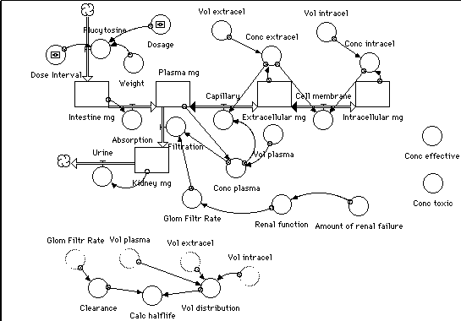



BiG DATA & machine learning
Overview
We have rich experience in processing large volume of data, analyzing range of potential correlations, relationships between disparate data sources and turn Big Data into usable knowledge through customized products and services, using algorithms like AI, Clustering, Adaptive, Logistic, Ridge regressions etc.
What we do
Following are some of our key service areas
Algorithms Implementation
Predictive
Analysis
Clustering & Classification
Data Visualization

Slide 10


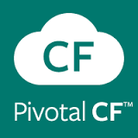

CLOUD COMPUTING
Overview
Extending the existing IT datacenter infrastructure using IAAS or running & managing your apps from anywhere using PAAS or using existing services that can be easily integrated into existing applications involves assessing and adopting the Cloud platform that best suits your ecosystem. Having partner who can help you do all this quickly will go a long way in achieving of your business goals.
What we do
We provide expertise in the following areas

Slide 11

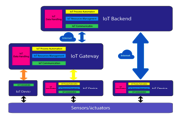

Internet of things
Overview
Internet of Things, offers unique opportunities for enterprises to establish connectivity to various systems and potential transformation enabled through connectivity. However the IoT ecosystem is quite fragmented and requires customers to deal with multiple vendors. We have a comprehensive set of service offerings and assets, to help customers unlock business value.
What we do
We provide expertise in the following areas
IOT Consulting
IOT Implementation
IOT Management

Slide 12





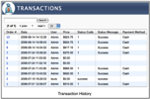

Sources of Analysis
Unstructured Data
Expense Receipts
Social Media Conversations
Blogs
Emails
Structured Data
Historical Data
Transaction History
User Behavior

Slide 13








Analytics offerings
Iot Integration
Warehouse & Inventory Mgmt.
Supply Chain Visibility
Reorder & Safety Stock Alert
Channel Optimization
Customer Segmentation
Discount Targeting
Competition Analysis
Automation
Marketing
Credit Risk
Fraud Detection
Accounts Payable Recovery
Anti-Money Laundering
Resume Screening
Employee Churn
Training Recommendation
Talent Management
HR
Risk Analysis
Call Center Analytics
Call Center Message Optimization
Call Center Volume Forecasting
Lead Prioritization
Demand Forecasting
Social Media Sentiment Analysis
Customer Support
Sales
Relationship Analytics
Strongest Link Prediction
Predicting Common Interests
News of Interest
Lost Discount Commitments
Contract Analysis
Expense Receipt Automation
Human Network
Finance

Slide 14


















Technologies
Languages & Frameworks
Machine Learning
Map Reduce Frameworks
Text Analytics
Sentiment Analysis
NO SQL/ Storage

Slide 15



























technologies
J2EE
JRules
STRUTS
BIRT
FRAMEWORKS / TOOLS
INTEGRATION
BUSINESS INTELLIGENCE
Yellowfin
DATABASE
BIG DATA
CLOUD
App Servers
MOBILE
iOS
SEARCH PLATFORM

Slide 16


Methodology
Agile/Scrum
Plan
Collaborate
Deliver
Create Tested Build to Meet a Defined Set of Objectives
Create Tested Build to Meet a Defined Set of Objectives
Create Tested Build to Meet a Defined Set of Objectives
Feedback
Feedback
Requirements
Requirements
Requirements
Analysis
Release Demo
Analysis
Release Demo
Analysis
Design
Design
Design
Implementation
Implementation
Implementation
System Test
System Test
System Test
Release to Customers
Customer Review and Acceptance
Customer Review and Acceptance

Slide 17
Methodology
Quick Snapshot
Release ( TDD + CI )
Project Management Tools:
Redmine
Jira/ Trac
RallyDev
QA Tools:
Selenium
JMeter
Soap UI
Deployment Tools:
Jenkins
Emma/ Cobetura
Build Automation:
CC.NET
Maven
Sonar
Documentation:
Wiki
Confluence
Initiation
Architecture
Construction
Construction
Construction
Stabilization
Iteration 0
Sprint 1
Sprint 2
Sprint 3
Sprint 4
Focus on:
Business Vision
System Study
Requirements
Process and Infrastructure Setup
Focus on:
Design
Architecture
Elaboration
Final
Release
User Interface Prototyping
Technology Evaluation
Proof-of-concept for risky design decisions (SPIKE)

Slide 18



Communication Model
Daily
Scrum
Weekly
Mid-Iteration Demos
Iteration
Iteration/Sprint Demo
Scrum of Scrums
Risk Management
Monthly
Engagement Review
Quarterly
Customer Satisfaction Survey
Weekly Status Tracking
Updates
Retrospective
Metrics
Time-sheets
Infocus – one-one review with team members
Metrics Revision
Monthly Management Reviews
Metrics
Best Practices
Execution Discipline
Deliverable Reviews
Quarterly Management Reviews
Areas of strength, Areas to Improve
Corrective and Preventive Actions for Areas of Concern
Address areas of concern and reinforce areas of strength

Slide 19
ILLUSTRATIVE COMMUNICATION MODEL
Core Team
Engagement Lead/Sponsor
Engagement Lead
Communication Channels
Face to Face
Telephone
Skype
Email
Execution Team
Legend:
XANBELL
CLIENT
Product Manager
Scrum Masters / Developers/ Testers

Slide 20
Selected
Case Studies
Big Data & Mobile
Relevant
Case Studies

Slide 21



CASE STUDY I
A U.S. Health care organization wanted insight into their data to identify procedures to improve patient care while reducing healthcare costs
Big Data Analytics
Health care organization
Location: US
Process several hundred thousand patients’ hospitalization records
Over a decade worth information, collected from over a 125 hospitals
Identify methods to reduce healthcare costs
Reduce patient readmission to avoid penalties
Predict cost benefits with increased Length Of Stay when compared to Emergency Readmissions
Use of Big Data technologies to process extremely large scale of data
Extract data from electronic medical record clinical free-text
Applied machine learning techniques for classification, feature selection
Batch and real time distributed processing for fast processing of data.
Designed, implemented and successfully delivered the POC on time.
Provided an optimally performing application providing high accuracy prediction
Used research oriented approach to trying different candidate solutions approaches
Final solution based on comparative evaluation, both from an ML and real life considerations
Technology Stack
Hadoop + Mahout
cTakes
MongoDB
Java
Spring BOOT
Momentum

Slide 22
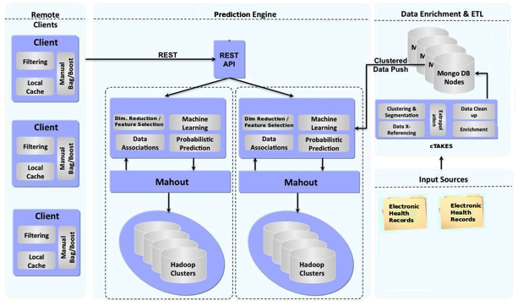
CASE STUDY I DESIGN

Slide 23
CASE STUDY I HIGHLIGHTS
Processed Electronic Medical Records (clinical free-form text) using open source NLP for medical records
Devised classifiers featuring both general demographics like age, gender, etc; AND medical specifics like primary + secondary diagnosis, number of medication, lab results
Constructed several models: Naive Bayes, Regressions (with regularizations), Random Forests, kNN
Selected the best based on a judicious mix of model evaluation metric (F1 score) and real life requirement (Accuracy of readmission prediction using Confusion Matrix)
Report generation involved:
Computation of comparative expenditures. Some example reports:
Average savings: Extending LOS v/s LOS + emergency readmission
Average savings: Extending LOS v/s LOS + non-emergency readmission
Complex aggregation queries on MongoDB listing similar symptoms which required readmissions

Slide 24

CASE STUDY II
CUSTOMER
BUSINESS OVERVIEW
SERVICES PROVIDED
A US based startup wanted to develop a data management platform to process TV viewing records from different data sources and classify users into different segments based on their viewing pattern
Big Data Analytics
Stealth Mode
Startup
Location: US
BUSINESS PROBLEM
Process 100 Million TV viewing logs data everyday
Provide recommendations for the programs and advertisement that a particular user might be interested in.
Generate aggregation reports on the viewing of a universe of TV viewers
Classify unknown users into different segments based on their viewing habits
SOLUTION
Use of Big Data technologies to process extremely large scale of data
Applied machine learning techniques for classification, clustering and recommendations
Batch and real time distributed processing for fast processing of data.
RESULTS/ DELIVERABLES
Designed, implemented and successfully delivered the first two phases of the application on time.
Provided optimally performing application to process large amount of data and high accuracy of the recommendations generated.
Used a research oriented approach for trying different candidate solution approaches before deciding the final solution
TECHNOLOGY STACK
Hadoop + Mahout
Twitter Storm
MongoDB
Myrrix
Java
Momentum

Slide 25
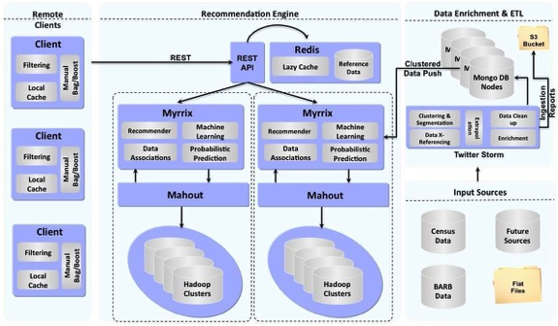
Case STUDY II Design

Slide 26
Case STUDY II HIGHLIGHTS
Devised a Bayesian Classifier Based on Viewing History and Data collected from Open Sources, that classifies a Customer / Viewer into certain demographics like age, gender, etc.
Constructed a Weighted Linear Regression Algorithm for predicting viewing patterns of Customer Segments based on historical data, region and demographics.
Report generation involved complex aggregation queries on MongoDB. Some example reports:
Adverts Viewed by each Customer in the course of each day, split hourly
Viewing Habits of each Customer; for instance, the top 10 programs viewed, top 10 recommendations, etc
A similarity report which lists each program along with the programs which are most similar to it.

Slide 27
Selected
Case Studies
IoT & BI
Relevant
Case Studies

Slide 28
Case STUDY#1 – SMART IMS on Paas
Inventory Management System is heart for any company. XanBell’s Smart IMS system leads to more organized warehouse and help save time & money
Highlights:
RFID technology based inventory management solution for component manufacturing
This application is based on Cloud Foundry Architecture & deployed on PAAS systems like GE Predix, Pivotal Cloud Foundry & IBM BlueMix.
Extensible to other sensors like Barcode, Temperature, GPS, Active tags etc.
Mobile Application to mange & view inventory
Zero Software maintenance & scalable solution which supports rapid delivery of new features & capabilities

Slide 29
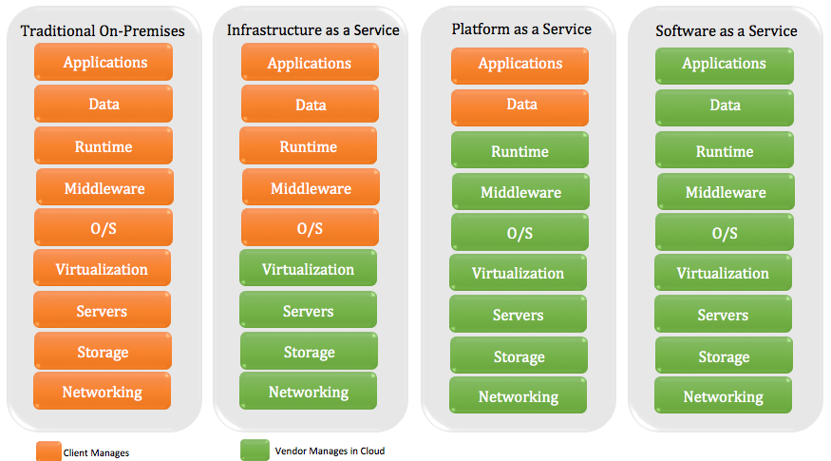
PAAS Faster innovation

Slide 30
Inventory Management - Features
Inventory optimization & visibility
A. Reorder point
B. Optimum Order quantity
C. Inventory cost
D. Safety Stock Alert
Inventory Reservation
Build-to-Order (BTO), Make-to-Order (MTO) - this strategy is typical for high-end motor vehicles and aircraft.
Assemble-to-Order (ATO); Assemble-to-request(ATR) – this approach is typical in product customizing e.g. Turbines
Reservation Optimization (RO); Reservations are optimized by algorithms based on availability, distance of warehouse from assembly unit, etc.

Slide 31
Unique Advantage of the solution
Tag Supported:
Passive –Active RFID modules, UHF reader modules, Bar codes reader, NFC & OCR
Does not require light of sight
Reduced Labor Cost
Real time update & Faster Scanning
Can Hold large amount of different type date
Sensor Advantage
Externalization of Data Reader Type
Micro Service Architecture
PaaS (Platform As
Service)
Application life cycle management
Centralized management
Distributed environment
Easy integration & maintenance
Improves fault isolation, Eliminates long-term commitment to a single technology stack
System resilience
Scalable & Easy to Deploy

Slide 32
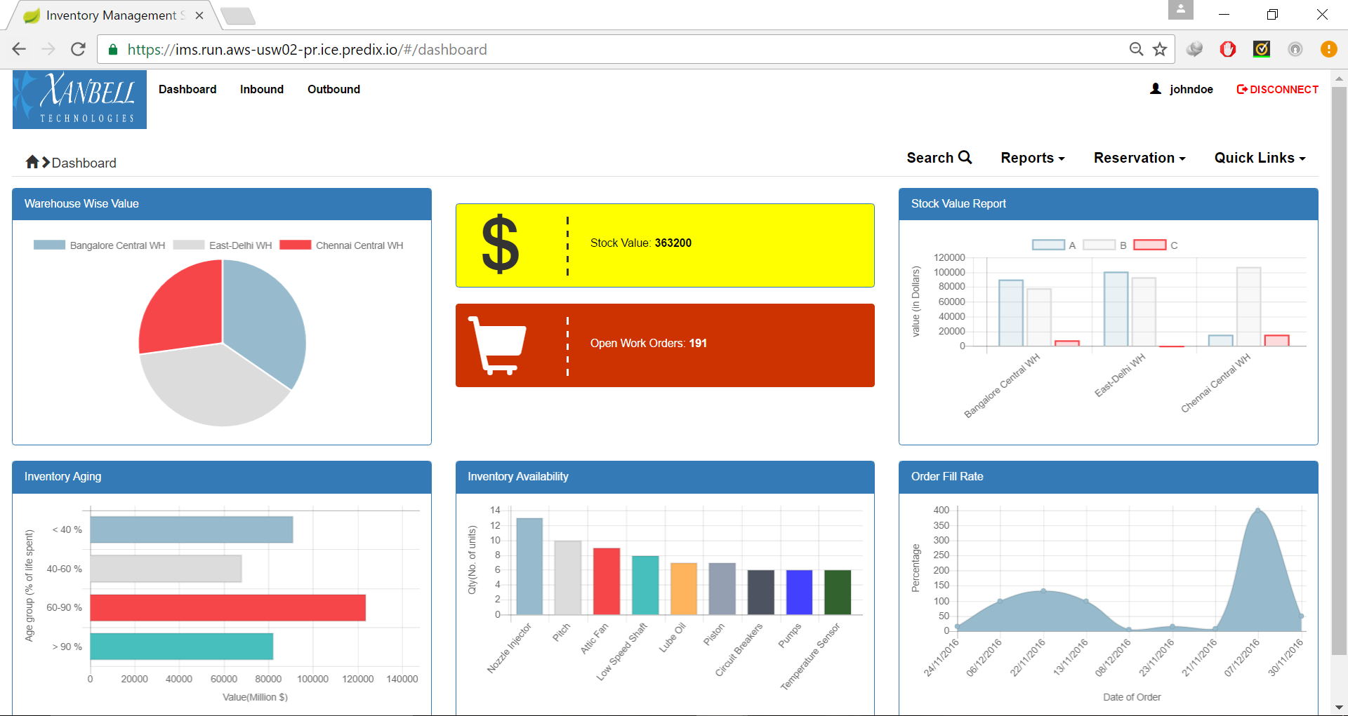
INVENTORY Management DASHBOARD

Slide 33
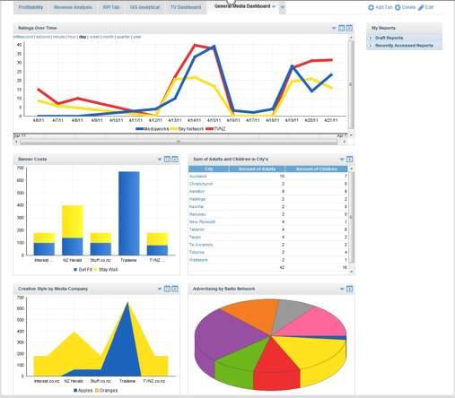
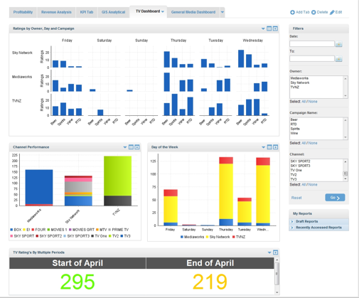
inventory Management dashboard

Slide 34
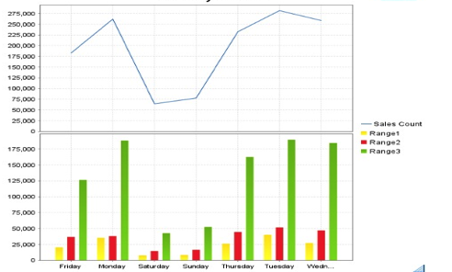
Case Study# 2 - BI Reporting for Nz Hospital
Problem Context:
Analyze and report the effectiveness of campaigns through Media
Direct data uploads for analysis of Media effectiveness
Assignment Highlights:
Developed Dashboard and customized BI Reports, that would source data from the data loads directly
Separate Dashboards for Summarized data and Media specific data
Ability to compare the metrics for multiple date ranges
Ability to view reports and dashboards over the browser, and to export to pdf, doc and other common formats
Products/Platforms:
Tomcat 6.x , Yellowfin BI 5.2, Talend Studio 5.x , Sql Server 2008 & Vector wise 2.x

Slide 35
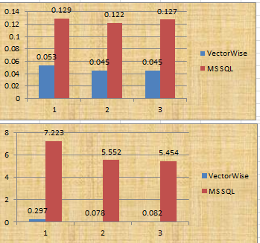
case study# 3 - migration for BI Application
Problem Context:
Media Metrics BI Reporting Application used MS SQL Server database and Yellow Fin BI tool.
Vectorwise (VW) is a new generation fast database for Analytics Applications from Actian/Ingres corporation.
Migrate Schema, Data and SQL code from MS SQL to Vectorwise (VW) and use Yellow Fin BI tool to connect to Vectorwise database.
Assignment Highlights:
Migrated Yellow Fin Reports and Yellow Fin Meta Data from MS SQL to Vector wise DB.
Achieved 2 to 5 fold performance improvements in the reports delivered to Media Metrics Application users.
Products/Platforms:
Vector wise 2.x, Talend Studio 5.x , Yellowfin BI 5.2 , Tomcat 6.x, MS Sql Server 2008.

Slide 36


Additional Queries can be directed to:
Pankaj Pathak
Director & Co-Founder
ppathak@xanbell.com
+91- 9880505863
Sanjay Sharma
Director & Co-Founder
sanjay@xanbell.com
+91- 9902344944

